Slide 1
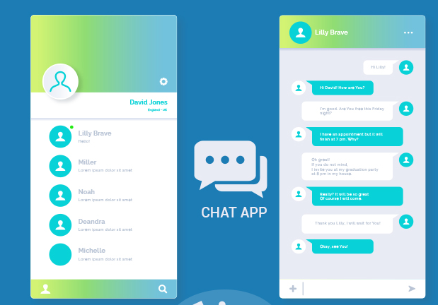
CS251 CHATTERBOX
Aman Sharma
Vijay Balsubramaniam
Aditya Singh

Slide 2
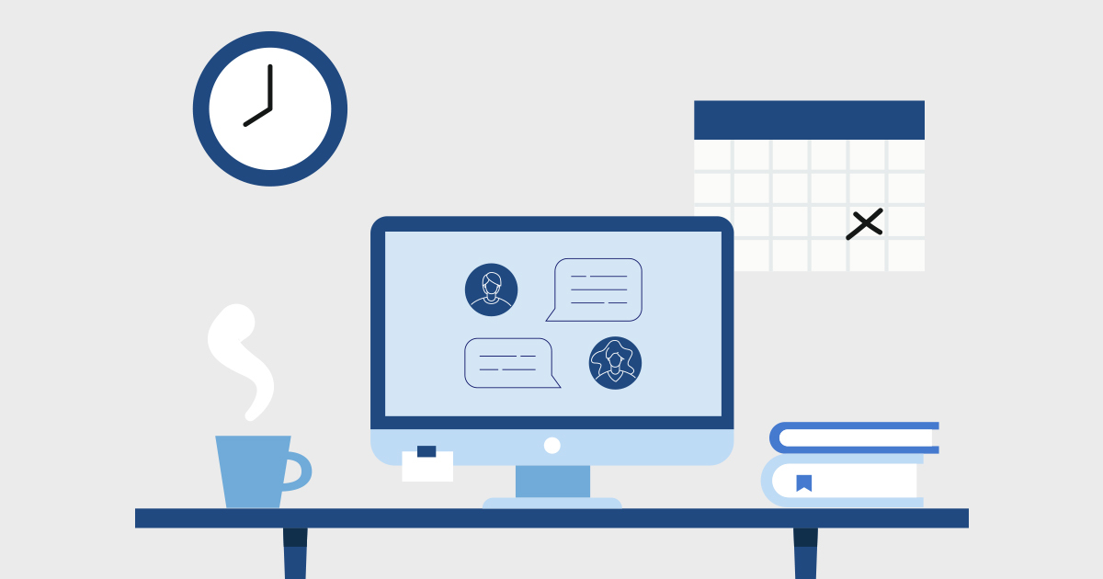
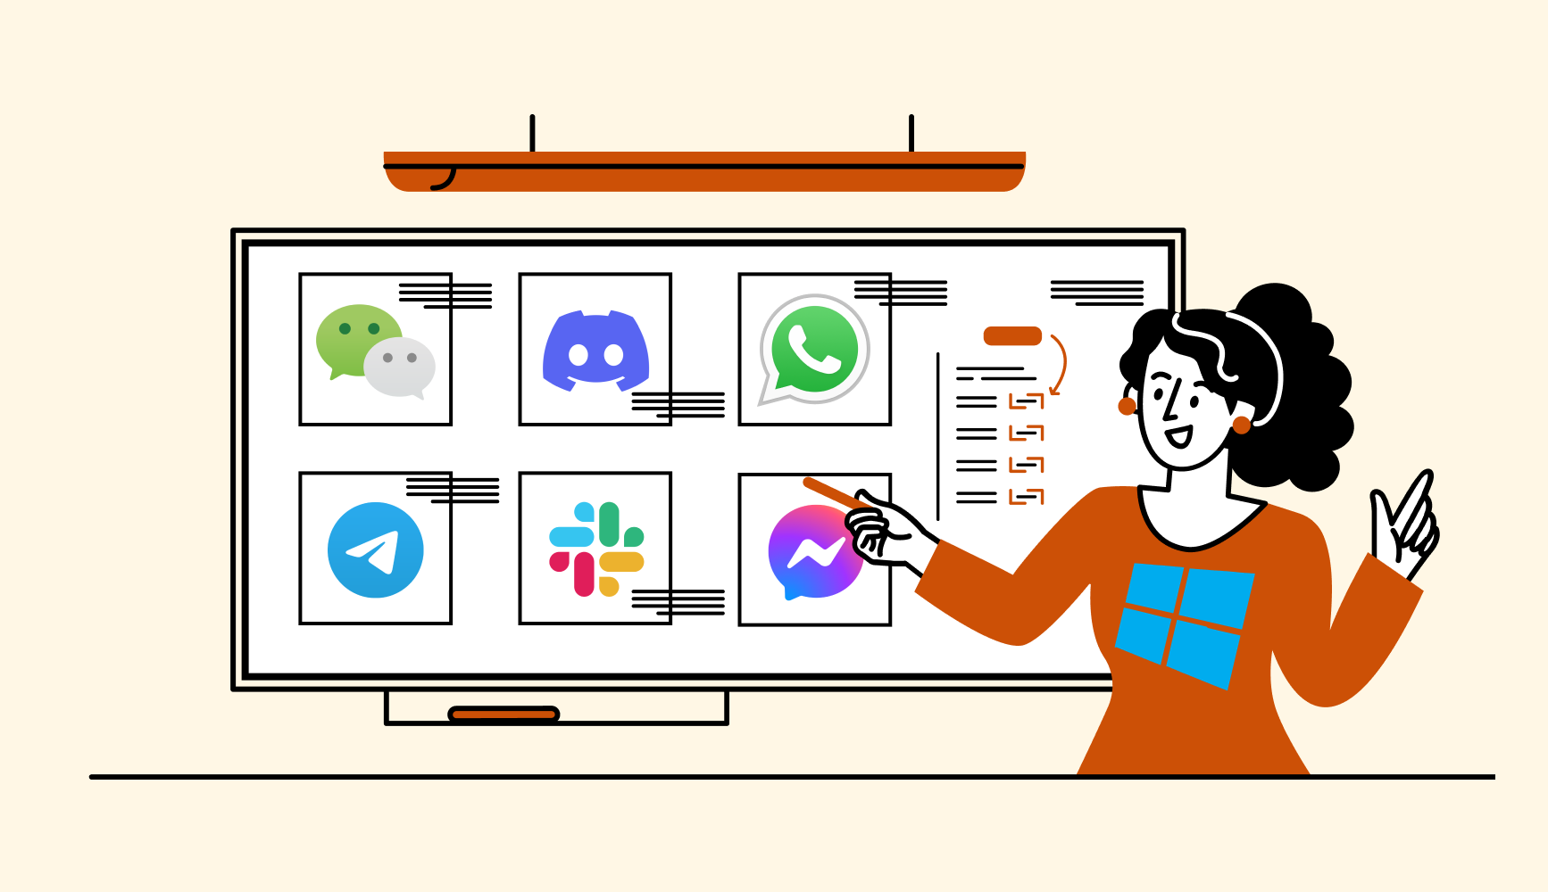
Project Agenda
What have we done so far?
Database System and File system
The basic Group Chat functionality
Load Balancing
The Road Ahead

Slide 3
What have we done so far?
The three of us have been working on three different aspects of the application:
Aman Database Design
Vijay Client Server Interactions
Aditya Load Balancer

Slide 4
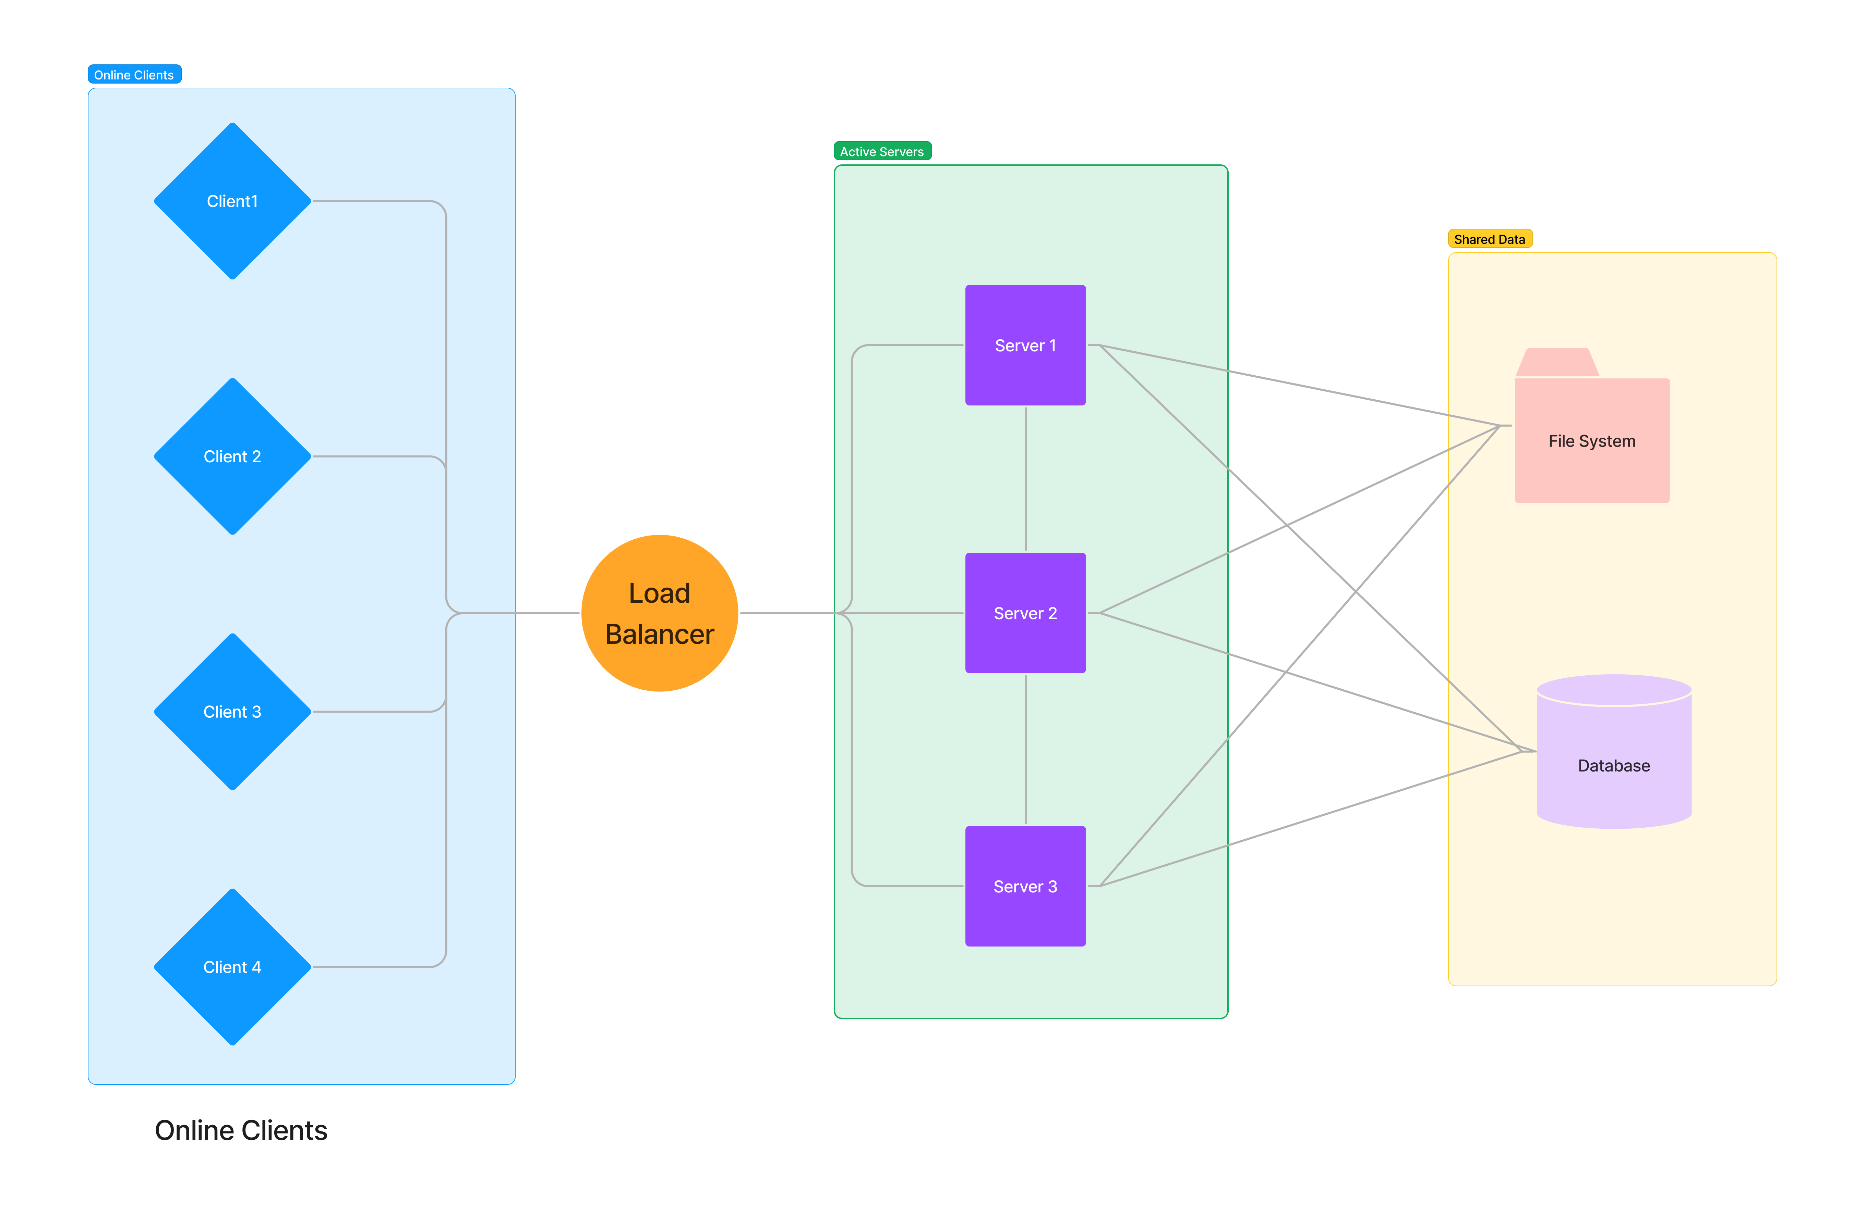
Overall Idea!

Slide 5
DATABASE DESIGN

Slide 6
Database Schema
 | User Table | Server Table
Primary Key | Phone Number
Foreign Key | -- | Phone Number
 | User Name | Server ID
 | Hashed Password
 | Age
The User Table will act as verification for the User Credentials during login.
The Server Table notes the server that User would be connected to. The Server ID set to NIL would mean offline status.

Slide 7
MULTI CLIENT GROUP

Slide 8
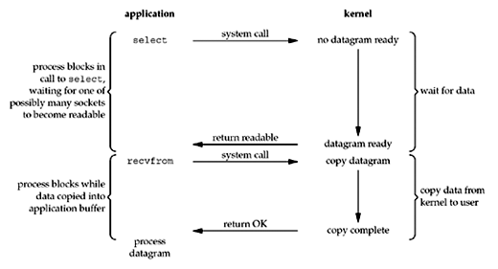
IO Multiplexing with Select.
Select.select() bifurcates sockets to be read, to be written and possible exceptions, in the main server loop, into readable, writable and exceptional sockets.
Our goal: Group Chats model all interactions with a group ID and a Personal Chat is a direct sending of message to a User ID

Slide 9
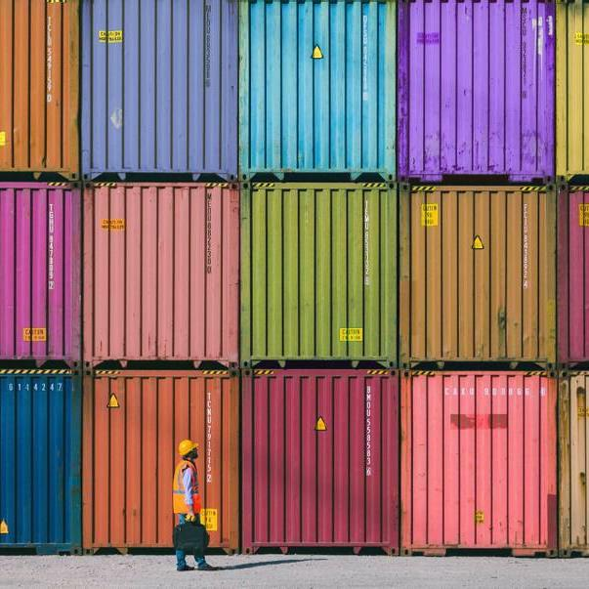
Demo
Caveat: Console at Client remains waiting for Client Input, shows messages only after input given, but can be worked around!
Crucially depends on select() of OS, but Python evens it across platforms.
Advantage: Using select is better for performance, especially when you could have potentially hundreds of simultaneous operations.

Slide 10
Load Balancer

Slide 11
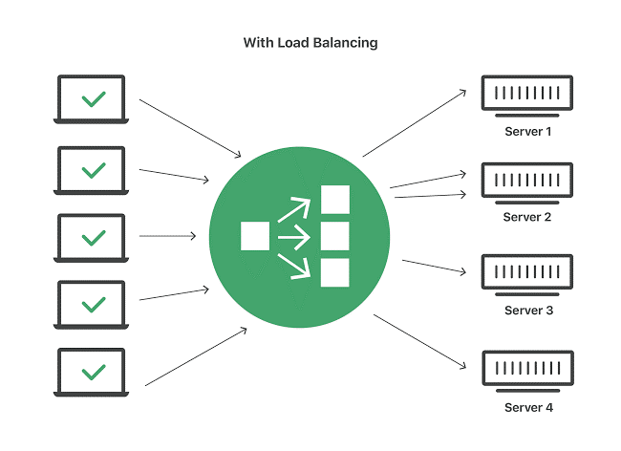
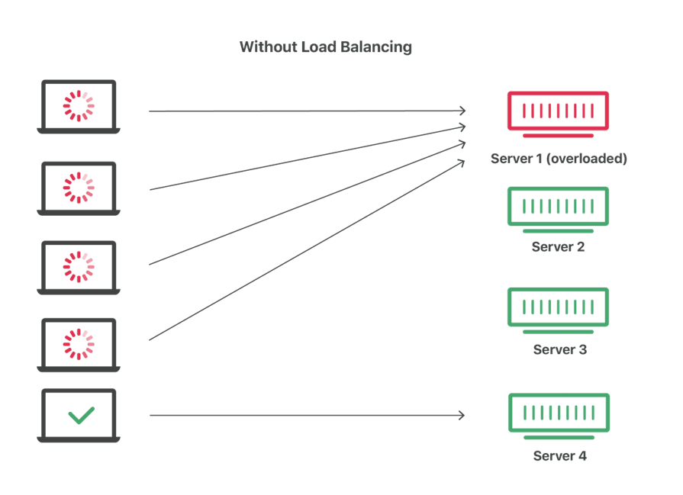
The right choice?
Least Connections Algorithm: In this algorithm, traffic is directed to the server having the least traffic. This helps maintain the optimized performance, especially at peak hours by maintaining a uniform load at all the servers.
We are using the Least Connections Algorithm in our project. It is quite efficient as whenever a new request is made by a client, it selects the server with the least number of connections. This prevents any server from getting overloaded.

Slide 12
THE ROAD AHEAD

Slide 13
Timeline
Primitive Database
Designing the basic schema, implementing simple functions demanded by the client-server interface
Handling of undelivered messages.
Primitive Chat
Designing interactions using select methods and creating a system ready to be merged with the Database
Choice of tools for the basic framework.
Merging the primitive systems
WE ARE HERE:
The Main Tasks
Adding Server-Server Interactions.
Locking.
Debugging.
Encryption.
Improve Console Interface.
Completing
Critique, Sphinx Docs
Merging the database and the group chat.
Building a simple console interface.
Credential Verification.
Parallel creation of Load Balancer.
Performance Analysis
Realistic Simulations.

Slide 14


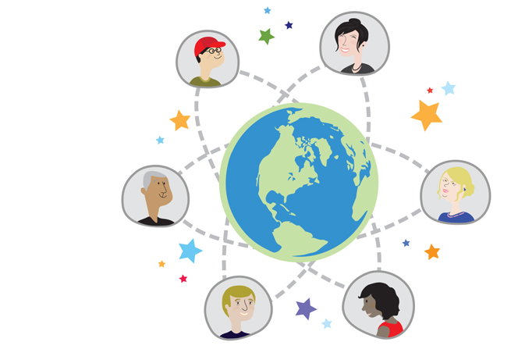
THANK YOU

